Slide 2
About this template
This template has been created to accompany the Good4Work website. It can be used by anyone promoting Good4Work to workplaces.
Use the template to create a presentation for managers and business owners to gain their support to introduce Good4Work in their workplace. It has been designed so you can tailor the title page and remove or add content that is not relevant to your presentation. There are also blank slides where you can insert your own content.
Delete this instructions page once you have finished tailoring the template.
The template and guidelines are free and available from hpa.org.nz/workplaces.

Slide 3
The benefits of a healthy workplace
For the people
Improved wellbeing
Reduced absenteeism
Increased energy and motivation
Increased job satisfaction
Increased work-life balance
Increased productivity
Improved staff morale and job satisfaction
Supports workplace health and safety
Improved corporate image
For the workplace
Notes:
Investing in a positive, healthy workplace reduces stress, fatigue, injury and error, and improve engagement productivity and innovation
Workplace wellbeing action is effective when it is integrated into everyday operations, not an extra thing you do.
There are many benefits for workplace wellbeing initiatives, including:
Increased productivity
Reduced absenteeism
Improved engagement
Improved morale and increased job satisfaction
Shows you care about your people, improving your image as a workplace of choice
Increased energy and motivation
Supports health and safety
Improved work life balance – which further improves the health and wellbeing of your people
IS WORKPLACE WELLBEING RELEVANT TO HEALTH AND SAFETY?
Addressing health and safety is required by legislation to manage risks in the workplace that could affect the mental and physical health and safety of your people. Workplace wellbeing is an optional way you can go above health and safety to show you care about the wellbeing of your people.
Workplace wellbeing may cover some similar issues in the workplace as health and safety. It may also help strengthen your health and safety actions by improving engagement and communication.

Slide 4
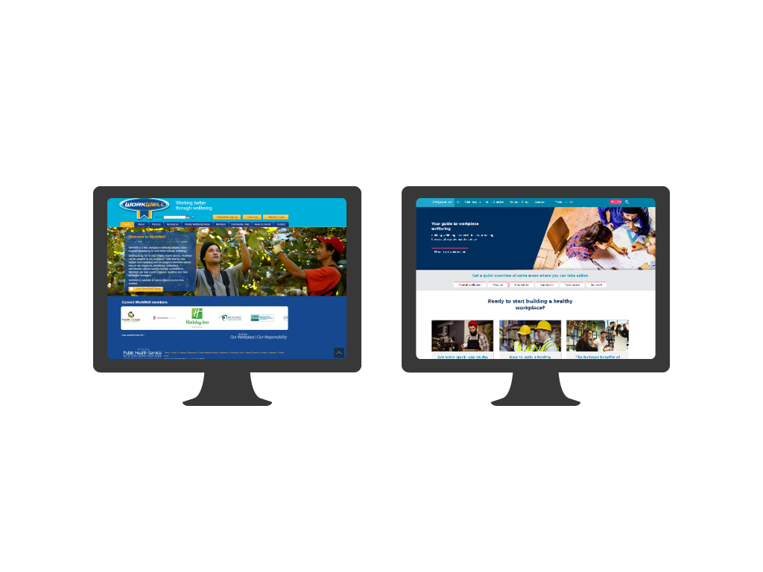
Good4Work joins WorkWell and Wellplace.nz
Notes:
Good4Work joins WorkWell and Wellplace.nz as the go-to places for workplace wellbeing, offering different support for different needs.
WorkWell includes advisor support and is ideal for larger organisations or those wanting to create a comprehensive programme and be accredited.
Wellplace.nz provides practical workplace health and wellbeing information, ideas, resources and case studies in one online location.
Good4Work has been developed as a collaborative project between Toi Te Ora – Public Health Service, Auckland Regional Public Health Service, Health Promotion Agency, Healthy Families NZ, the Ministry of Health, and business representatives.
It draws on the most up-to-date knowledge and experience of workplace wellbeing in New Zealand and incorporates the World Health Organisation’s best practice recommendations for a healthy workplace.
Business insight research and business sector involvement was part of the development process to ensure the resource is practical for NZ workplaces.

Slide 5
Integrate wellbeing into:
The way you lead
The way you work
The way you connect
The place you work
Notes:
Good4Work takes you through a step-by-step process to help you complete actions to change your workplace environment and culture.
Good4Work will help you find tangible things you can do to integrate wellbeing into your leadership, work practices, relationships and environments. This is summarised into four workplace areas of focus on Good4Work - the way we work, the place we work, the way we connect and the way we lead.

Slide 6
Good4Work is free, easy to use and flexible to your workplace
Notes:
Workplace wellbeing is effective when it is integrated into everyday operations, rather than being an extra thing to do.
Good4Work is free to use
It will take approximately 5-10 minutes to complete quiz
Your time and budget to engage people and complete actions is determined by you
Use the tool to create sustainable and integrated change
Good4Work can be used by any workplace that wants to get started with workplace wellbeing. It’s aimed at small-to-medium-sized workplaces but can be used by workplaces of any size.
The tool is designed to be used by someone in a workplace who understands the workplace’s environment, structure and practices and is able to lead change.

Slide 7
Take the quiz to rate your workplace

Slide 8
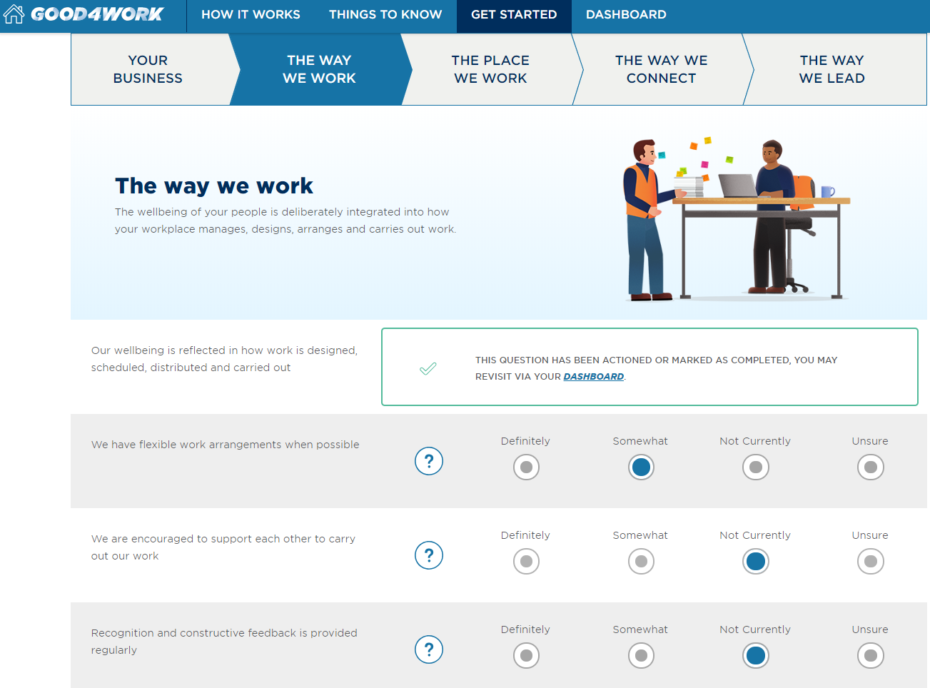
Notes:
Good4Work starts with a quiz asking you to rate where you think your workplace is at against 22 statement.
These cover the essential elements for a positive workplace culture and environment.
It focuses on four areas:
The way we work: The wellbeing of your people is deliberately integrated into how your workplace manages, designs, arranges and carries out its work.
The place we work: The physical environment and facilities in your workplace are designed to maximise the health and wellbeing of your people.
The way we connect: The people in your workplace are a team. They are supported to connect, stop and take notices of themselves, each other and their environment.
The way we lead: Your commitment to wellbeing is visible and talked about from the boardroom to the breakroom.
Your results provide you with a starting point and lead you to examples of things you can do to take action.

Slide 9
Send the quiz to your team to get their views
Notes:
Effective workplace wellbeing takes a team effort.
The aim is to build a positive culture of ‘this is how we do things around here’ across all parts of the business, supported by workplace policy, activities, communication and training.

Slide 10
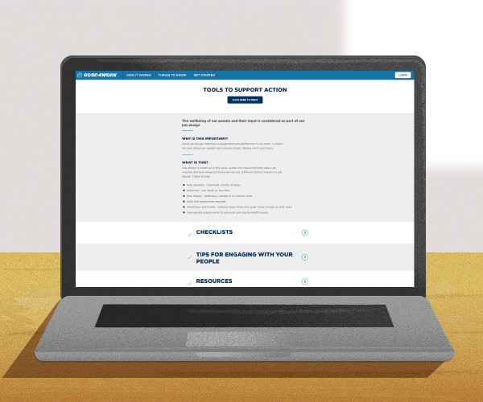
Use the tools to support action
Checklists to help prioritise actions
Tips for engaging your people
Ideas of things you can do
Resources to help take action
Notes:
Each of the 22 quiz statements have checklists to check your workplace and to check in with your people.

Slide 11
Compare the results to see where you can take action
Notes:
Decide what to work on.
Good4Work limits you to working on three actions at one time to help you stay focused and your actions manageable – ie, you can only move three actions into your ‘to do list’.

Slide 12
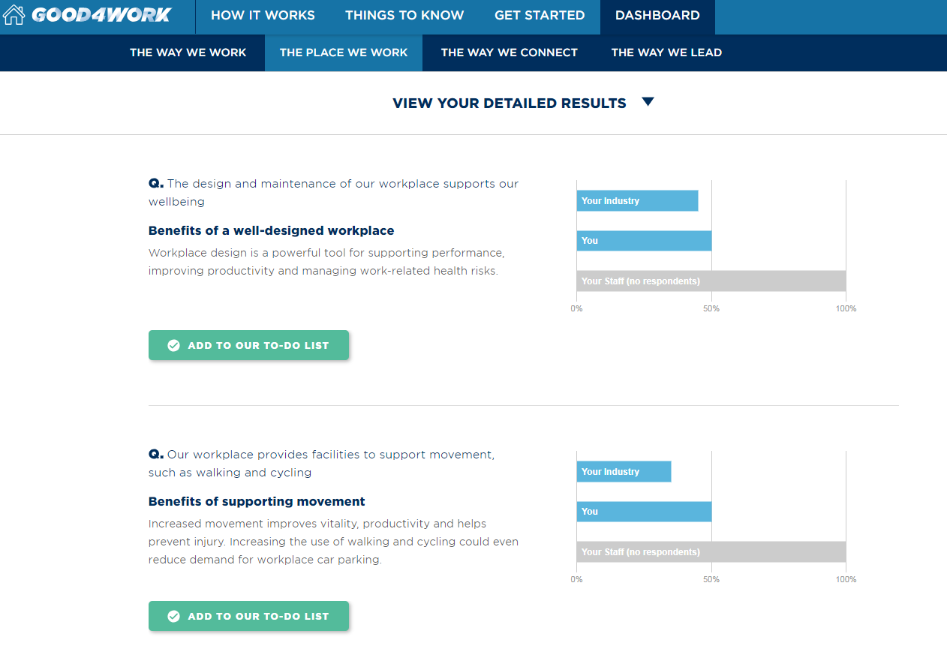
Notes:
It’s easy to add actions to your to do list – choose up to 3 to stay focused and manageable
You can also write your own actions

Slide 13
Use the tips and tools to make your workplace better
Notes:
Once you’ve completed your actions, move them to your completed list. And then look at your results and engage with your team to chose your next actions.

Slide 14
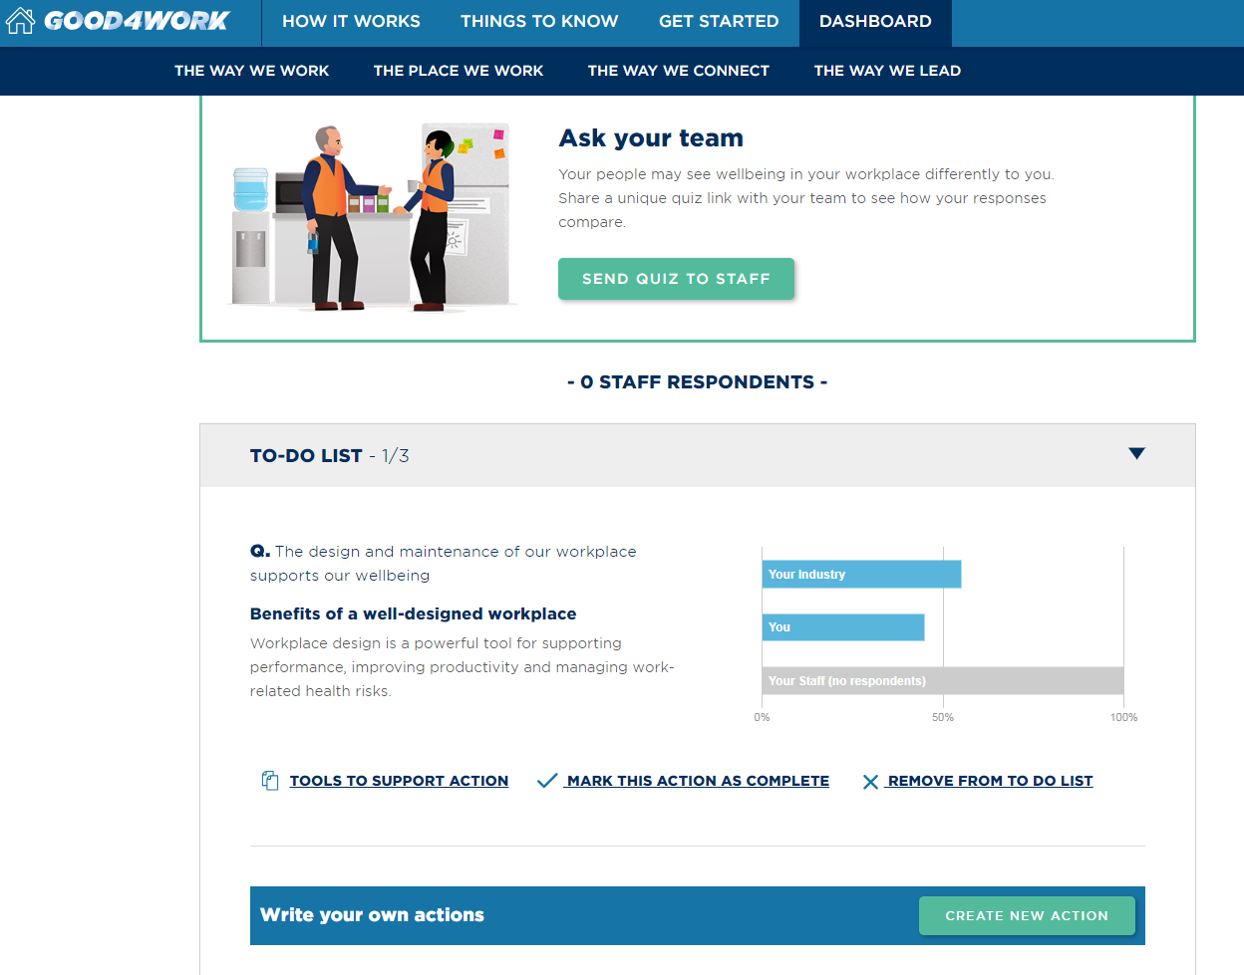
Notes:
Example of what your Good4Work action list could look like
You can also write your own actions
Revisit resources to help complete action and click complete action when done.
You can remove actions from your ‘to do list’ – they move back into your results board

Slide 15
Notes:
You must create an account to access your results.
Information is collected to administer, evaluate and improve the site, to improve services and to action or respond to information provided. Information is aggregated without personal identifiable information and anonymity is maintained. Your personal information will not be disclosed to other government agencies or other organisations without your consent, unless required by law.
We love to showcase the ways workplaces are creating wellbeing within their organisations. Email Good4Work@hpa.org.nz to share the actions you've taken.

