Slide 1
What staff need to know
Notes:
Help for the Tough Times is a pocket guide for teenagers. [show or hold up a hard copy of the resource]
It provides a quick guide to four NZ websites that were especially designed to support teens with issues like anxiety, stress, identity, relationships, and depression.
The pocket guide was developed for teens by teens. It was co-developed with students from two Year 12 high school classes. They advised and provided comment on the content, design, and format throughout all the development and design stages.
Copies of the cards are available from [insert details for your school]
This presentation is an introduction to the resources – the teen resource and the staff resource. It also serves as a timely reminder about our school procedures – what to do when you notice something or hear something about a student who is particularly anxious, stressed, or going through tough times.

Slide 2
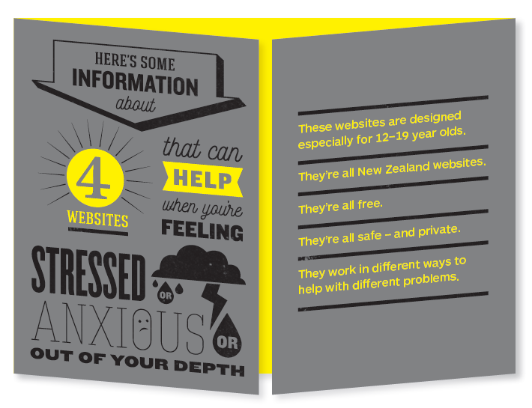
Notes:
The guide was designed especially for 12 to 19 year olds.
They’re all New Zealand websites. They all free and available 24/7. They’re all safe – and private. They work in different ways to help with different problems.

Slide 3
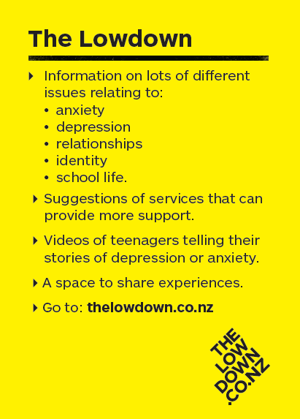
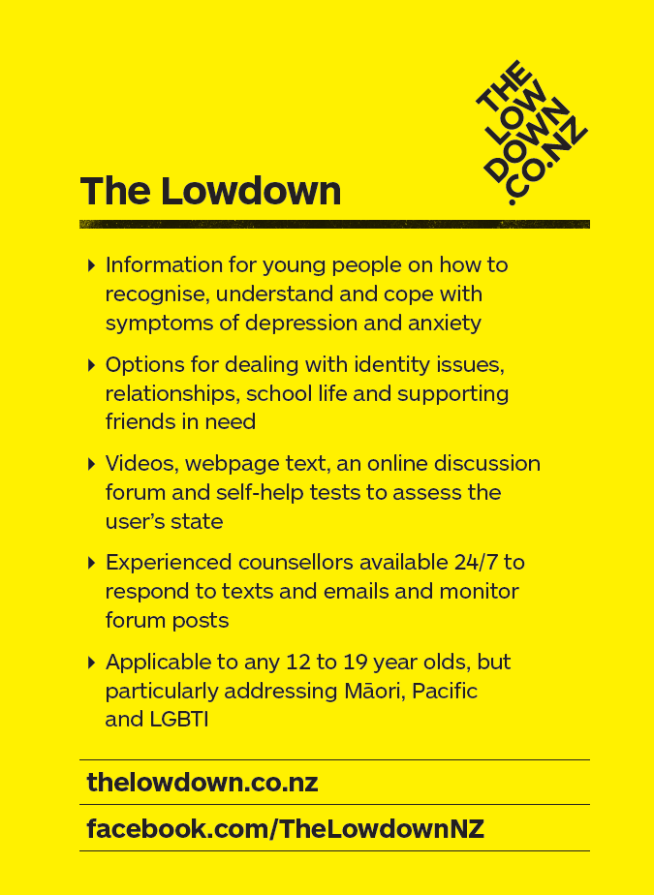
Notes:
The text on the left is from the teen guide. The teens told the developers:
to keep sentences short
to use mature language – “Don’t try to use the language that you think we use.”
they liked to be referred to as teens, teenagers – not young people or youth
to make it small and discrete (credit card size).
they liked statements that were straight forward
not to have too much information. Include the logo and url – “We’ll look it up anyway”.
As a result of feedback from pastoral care staff during the development stage, a reference guide for staff was also developed.
The text on the right is from the school staff reference guide. It provides more information aimed specifically for school staff on the four sites, as you will see on the next few slides.

Slide 4
Notes:
(Text from the school staff reference guide)

Slide 5
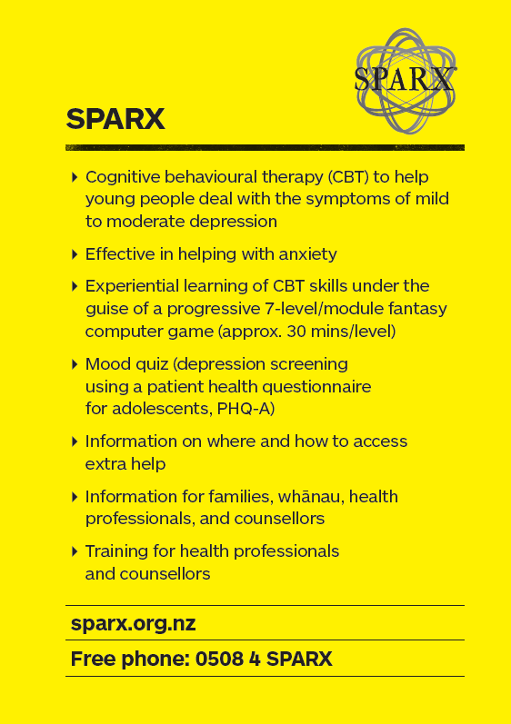
Notes:
(Text from the school staff reference guide)

Slide 6
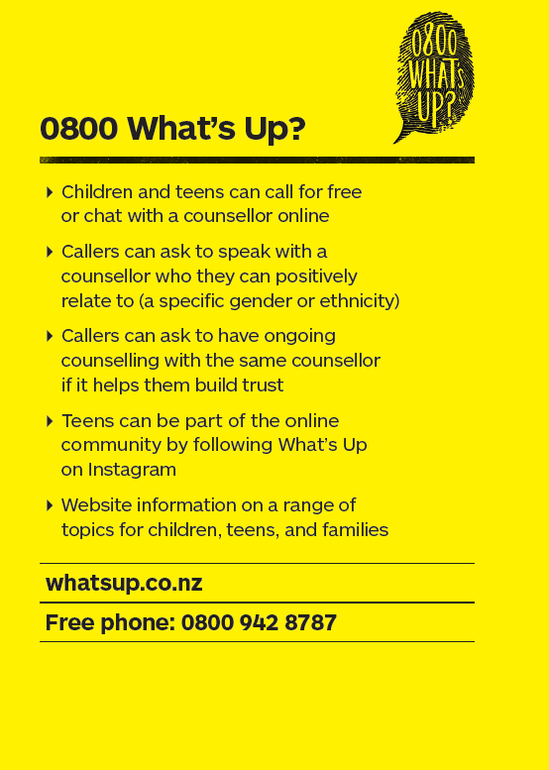
Notes:
(Text from the school staff reference guide)
Common Ground has good information for a teen who is supporting a friend who is going through tough times
It’s generally aimed at parents, whānau and friends – to recognise and understand the difficult situations that young people go through in their lives, and understand the support system a young person might have around them.
Common Ground might be a site that you refer parents and whanau to.

Slide 7
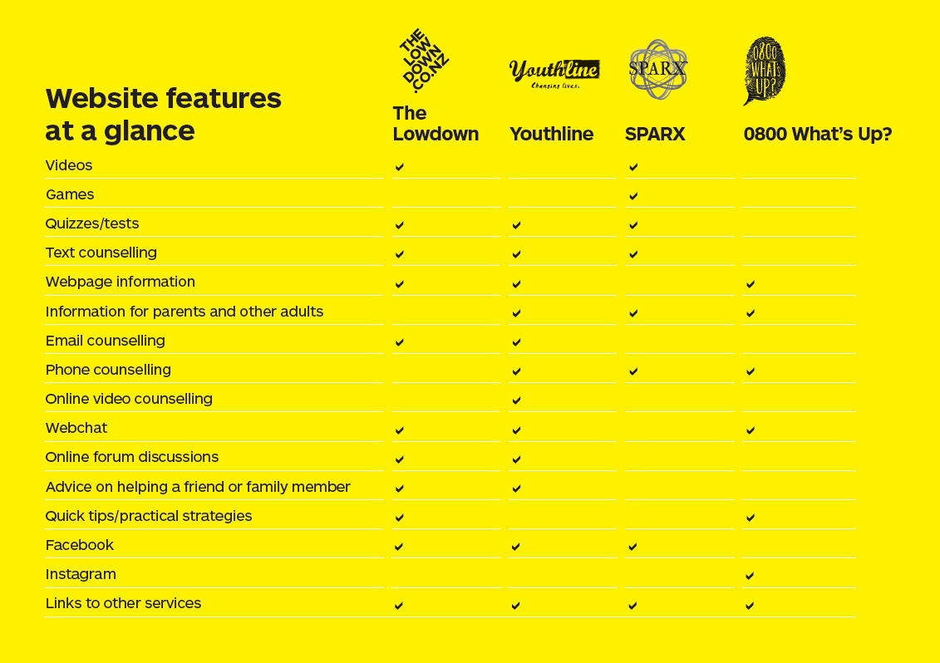
Notes:
This gives information for school staff on the four websites, as you have just seen.
It also has a quick reference guide. You might use this to suggest a particular website for a student to visit, based on the learning style or interests that you know about that student.
Copies have been printed out for each of you
Keep a copy in your planning book for quick reference.

Slide 8
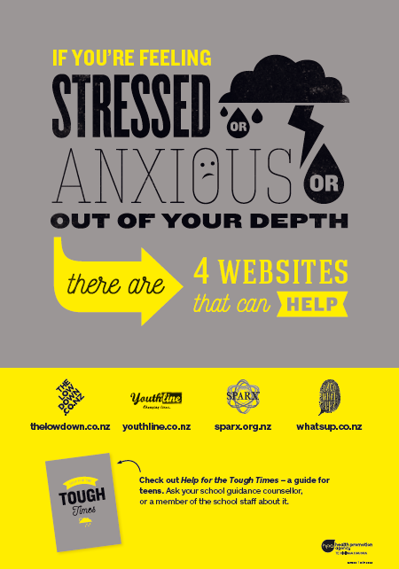
Notes:
The students involved in the development of the teen guide suggested that a poster would also be useful, so we have one of those, as well.
This poster is on display [insert where in your school the poster is displayed]

Slide 9
Adapt this slide to provide information on your school procedures regarding students who are anxious, stressed, depressed, or have mental health issues.

